Slide 1
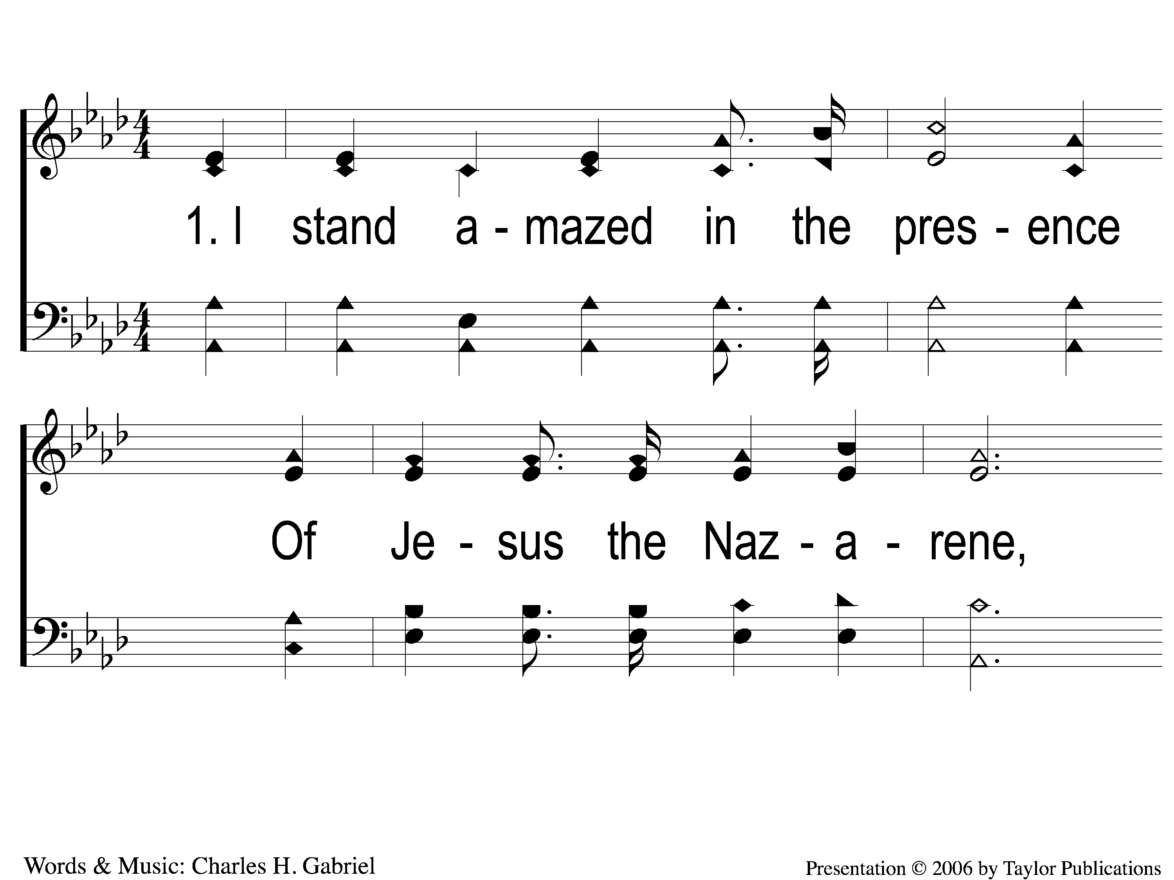
1-1 I Stand Amazed
I Stand Amazed
114

Slide 2
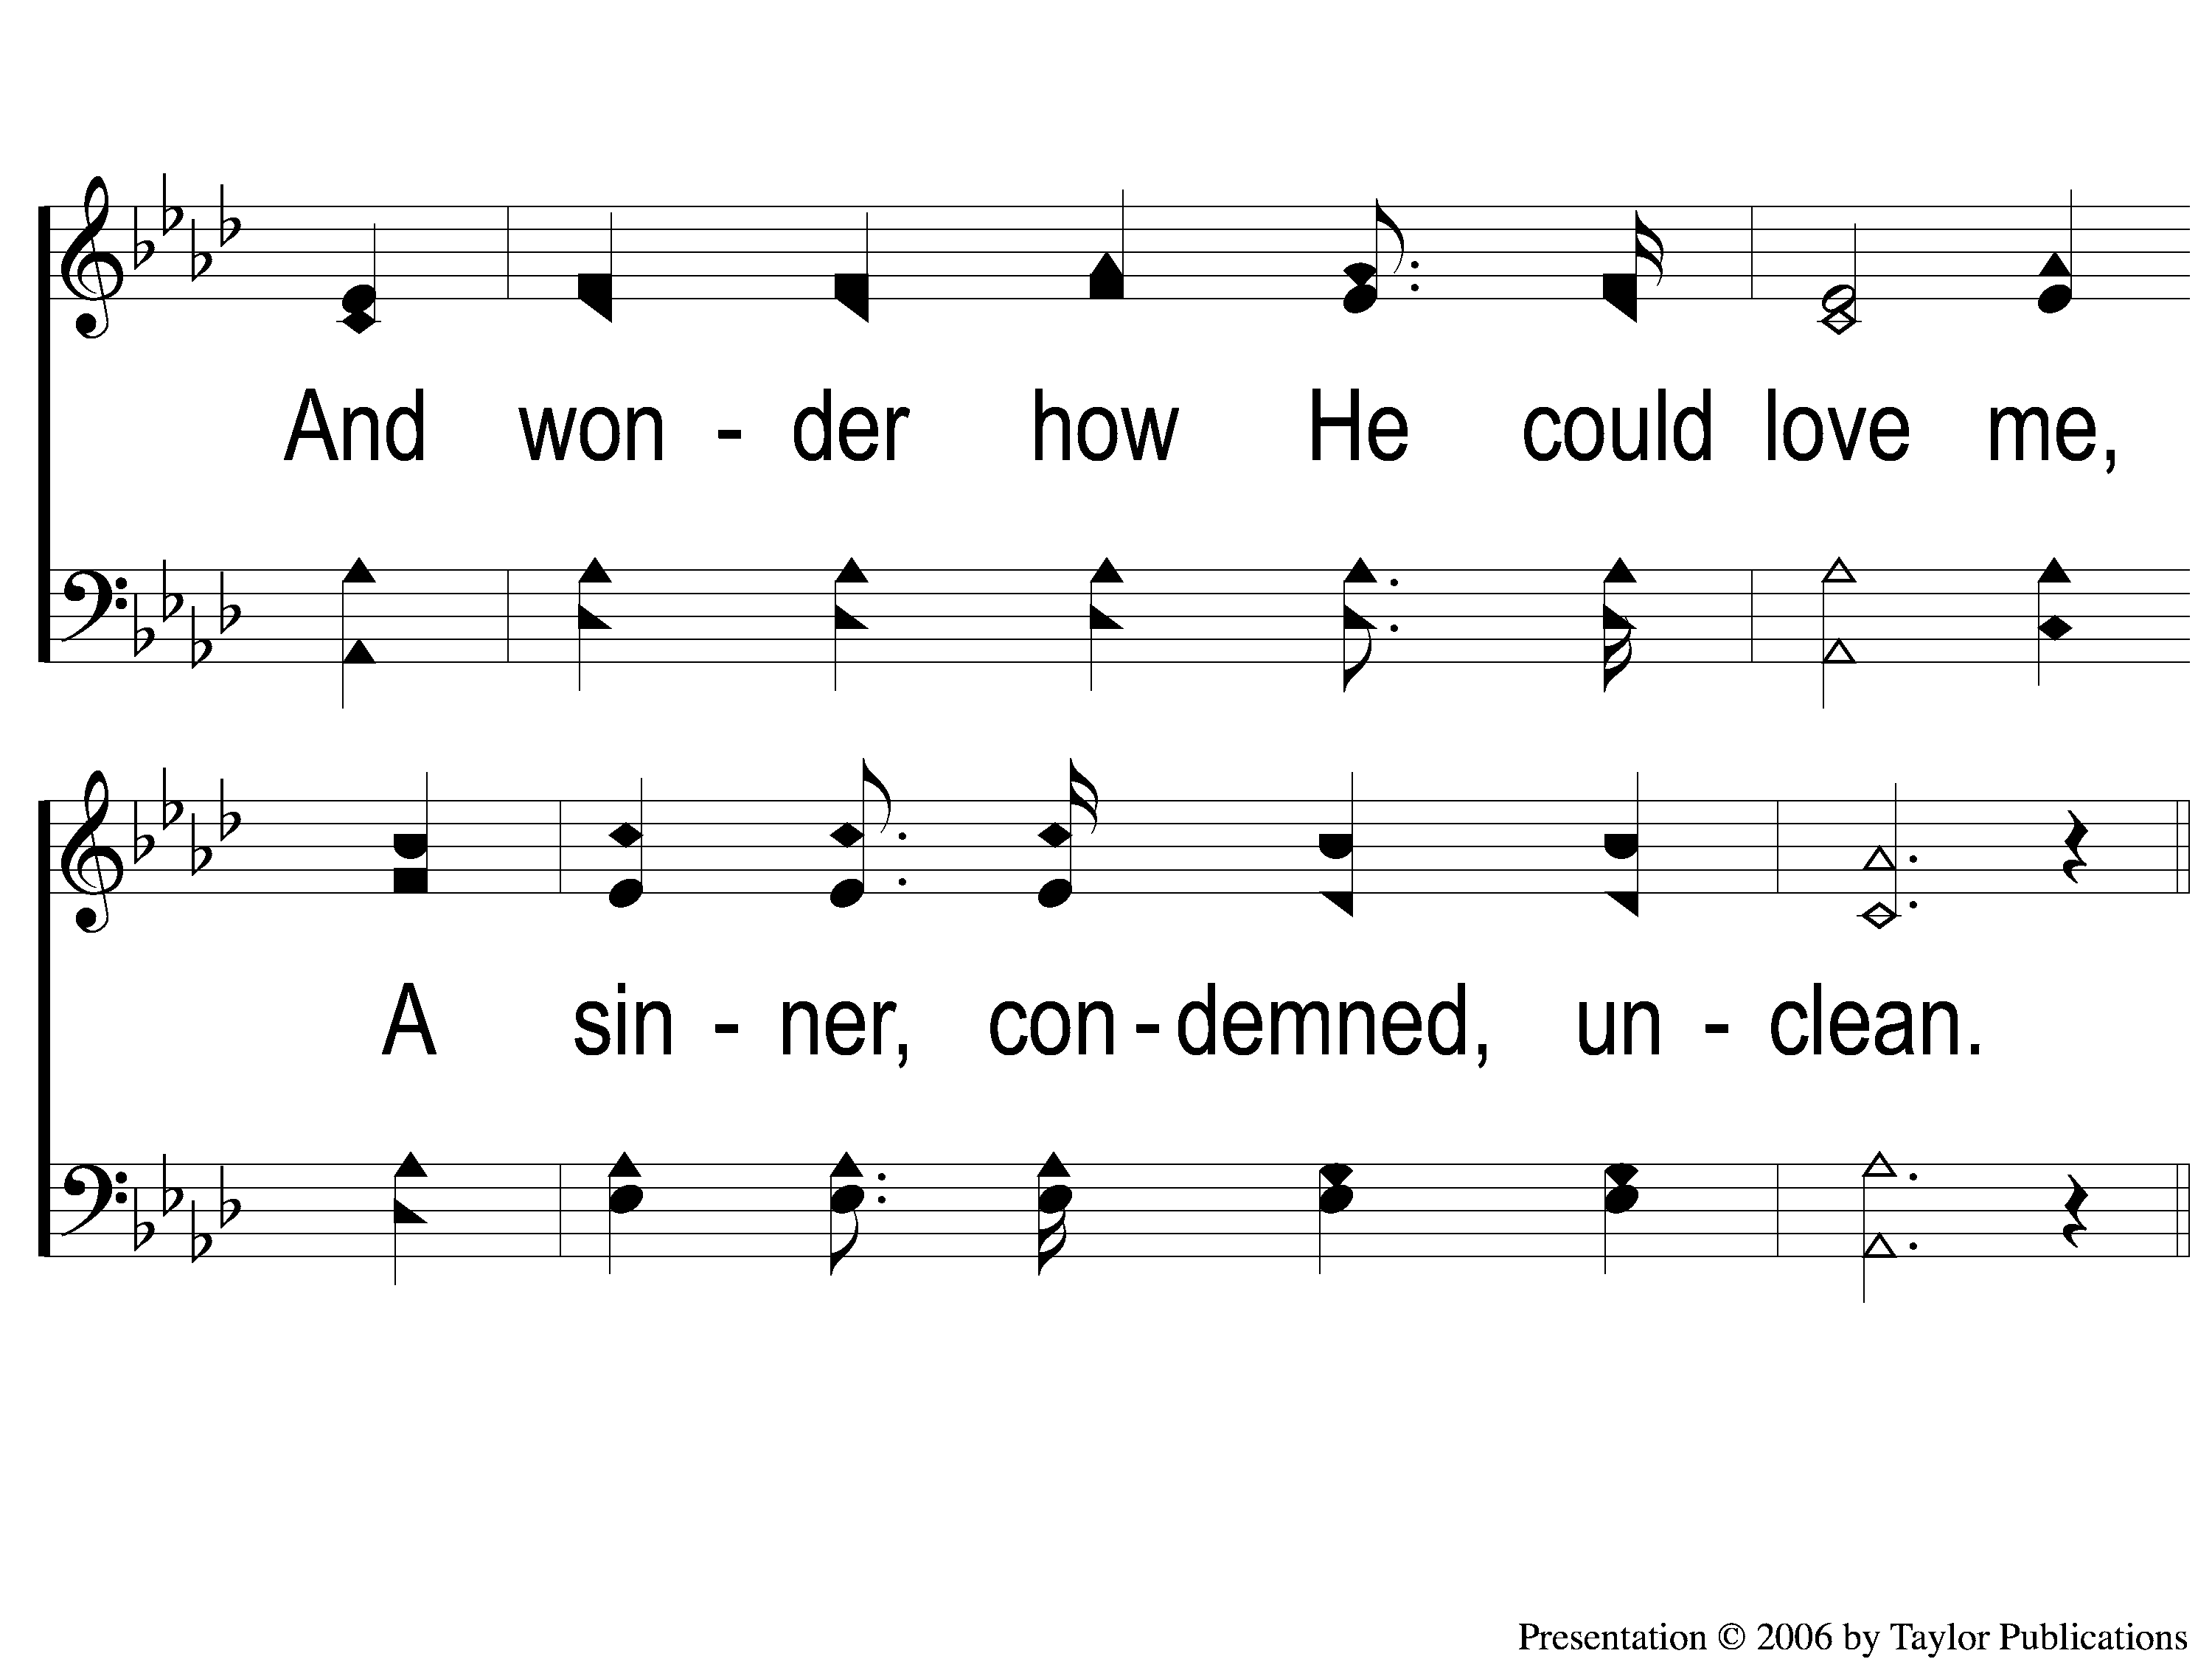
1-2 I Stand Amazed
I Stand Amazed
114

Slide 3
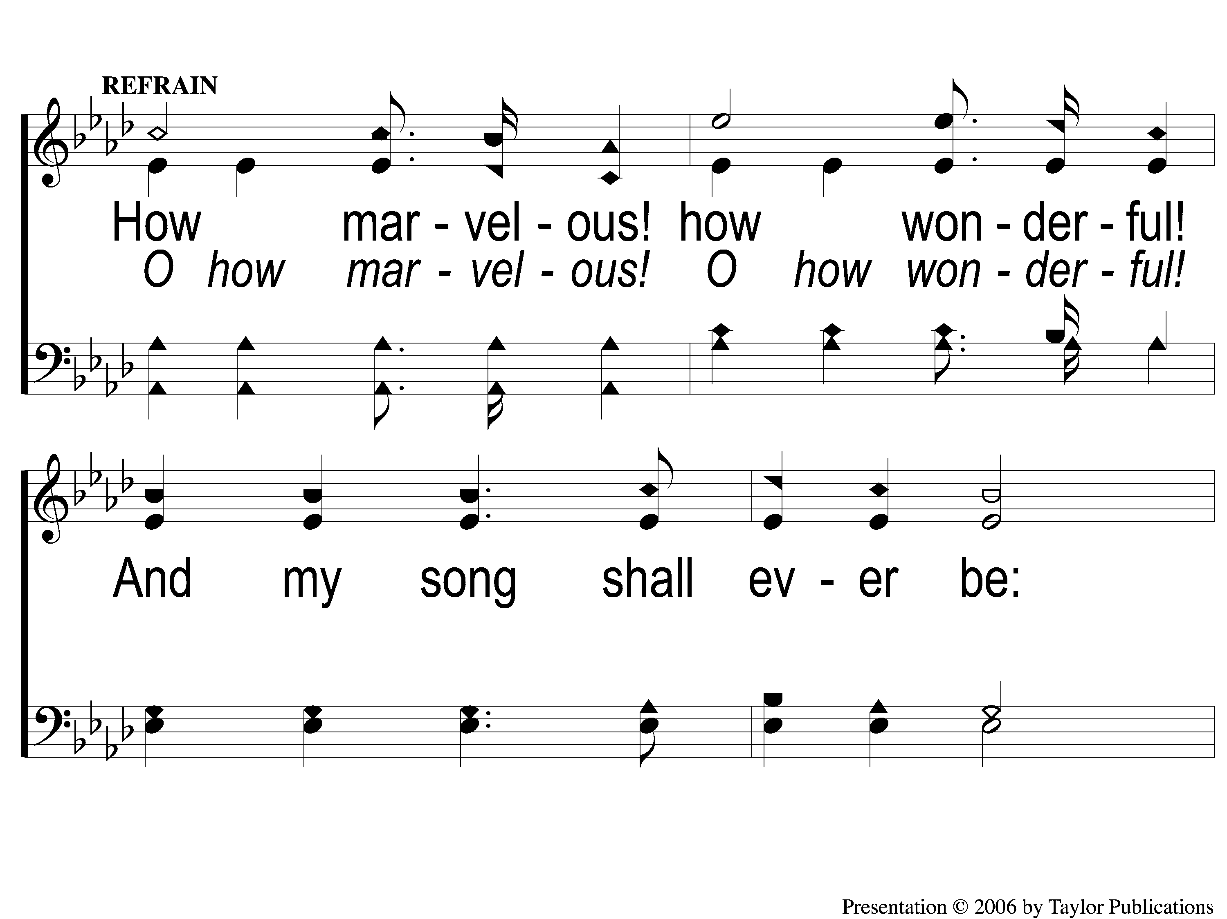
C-1 I Stand Amazed
I Stand Amazed
114

Slide 4
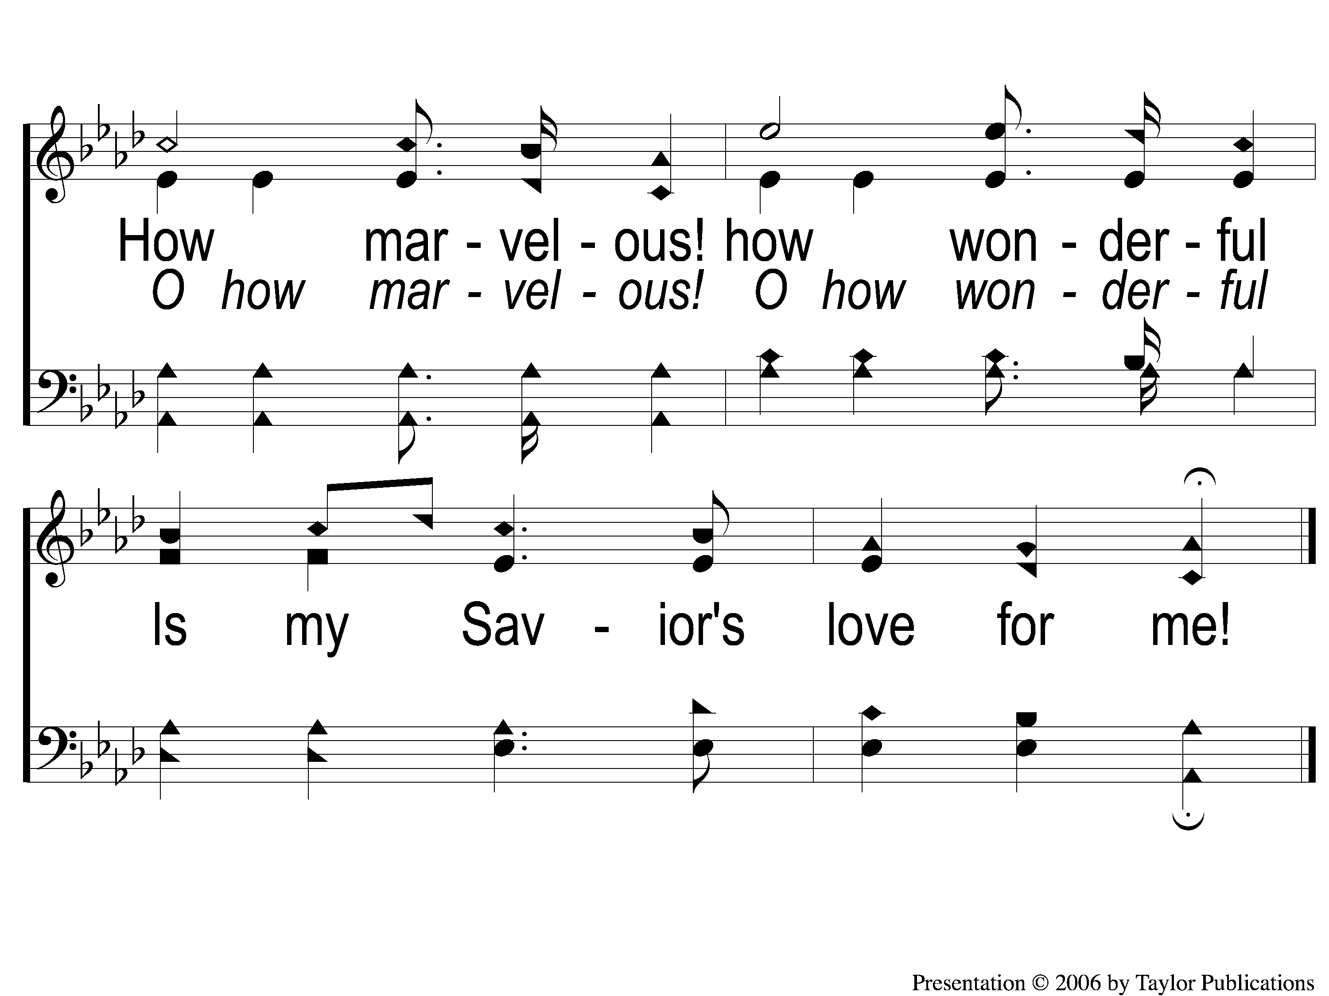
C-2 I Stand Amazed
I Stand Amazed
114

Slide 5
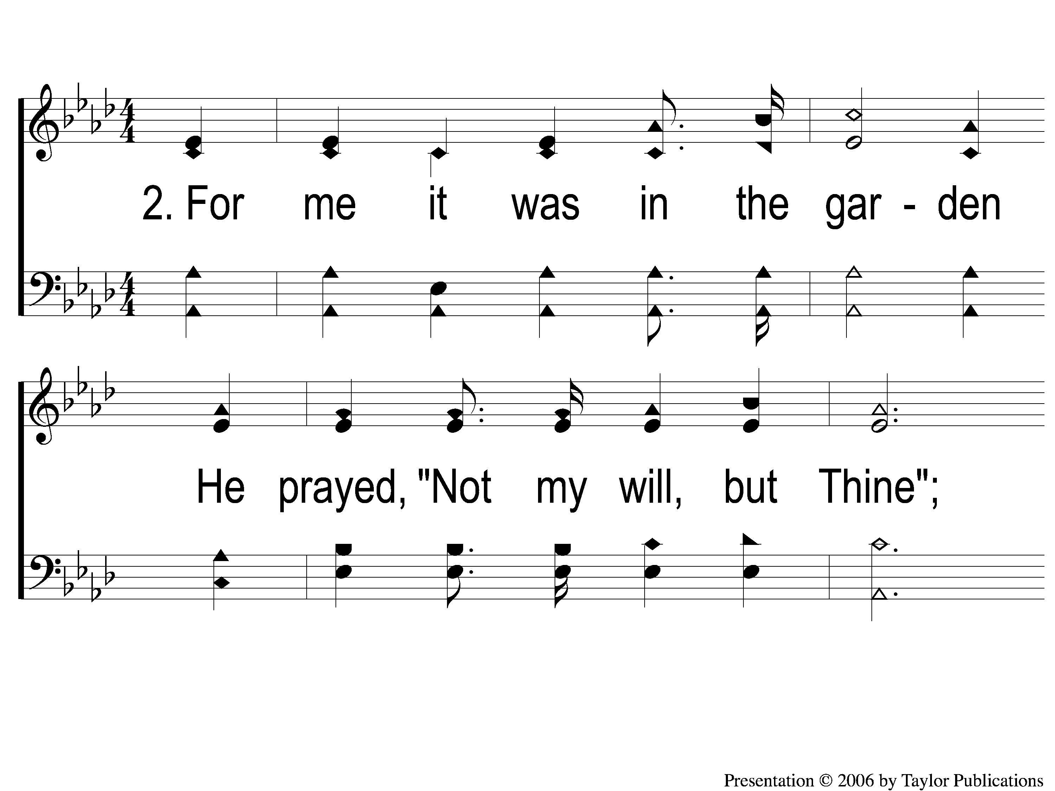
2-1 I Stand Amazed
I Stand Amazed
114

Slide 6
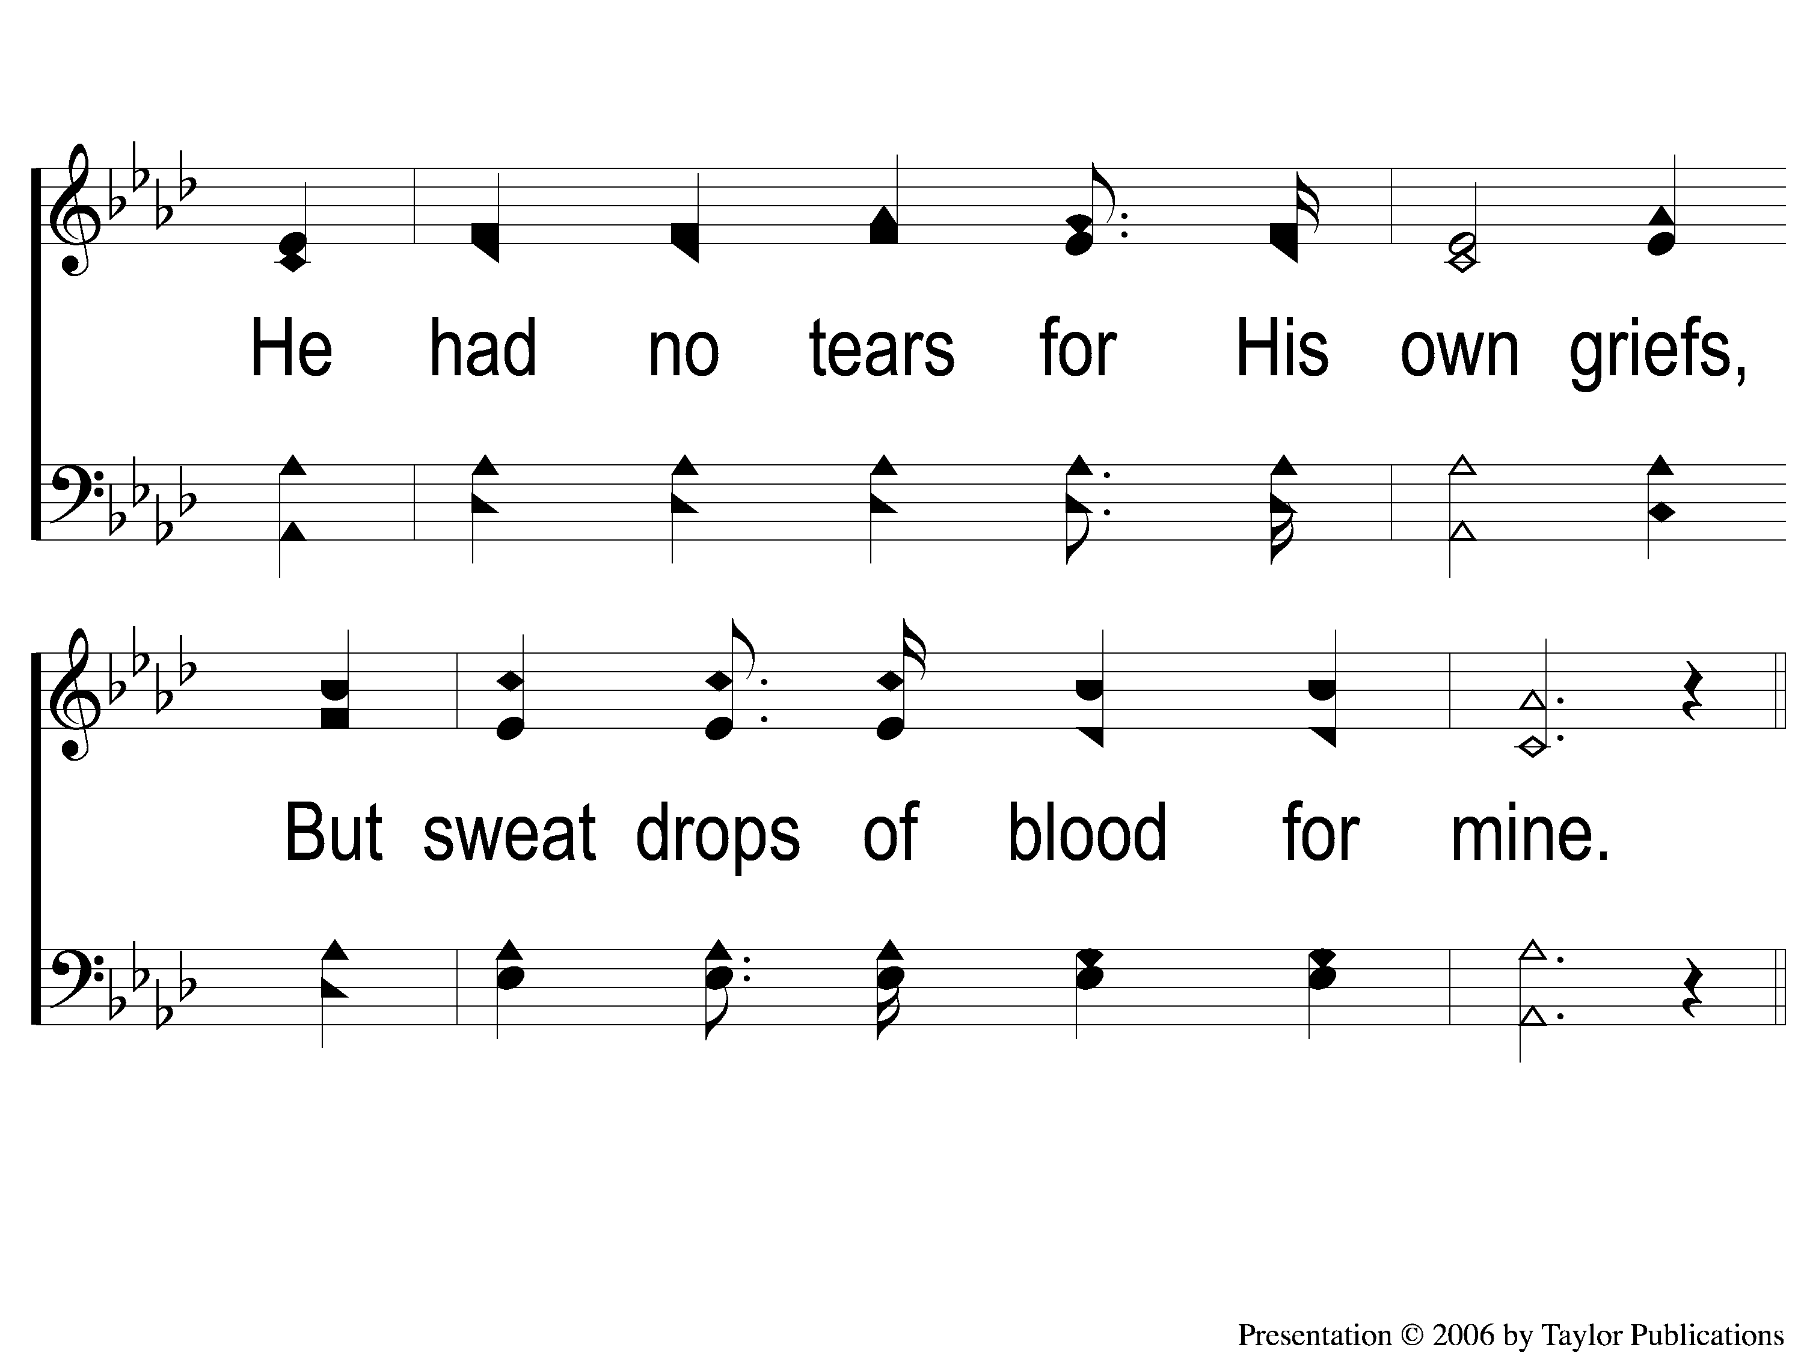
2-2 I Stand Amazed
I Stand Amazed
114

Slide 7
C-1 I Stand Amazed
I Stand Amazed
114

Slide 8
C-2 I Stand Amazed
I Stand Amazed
114

Slide 9
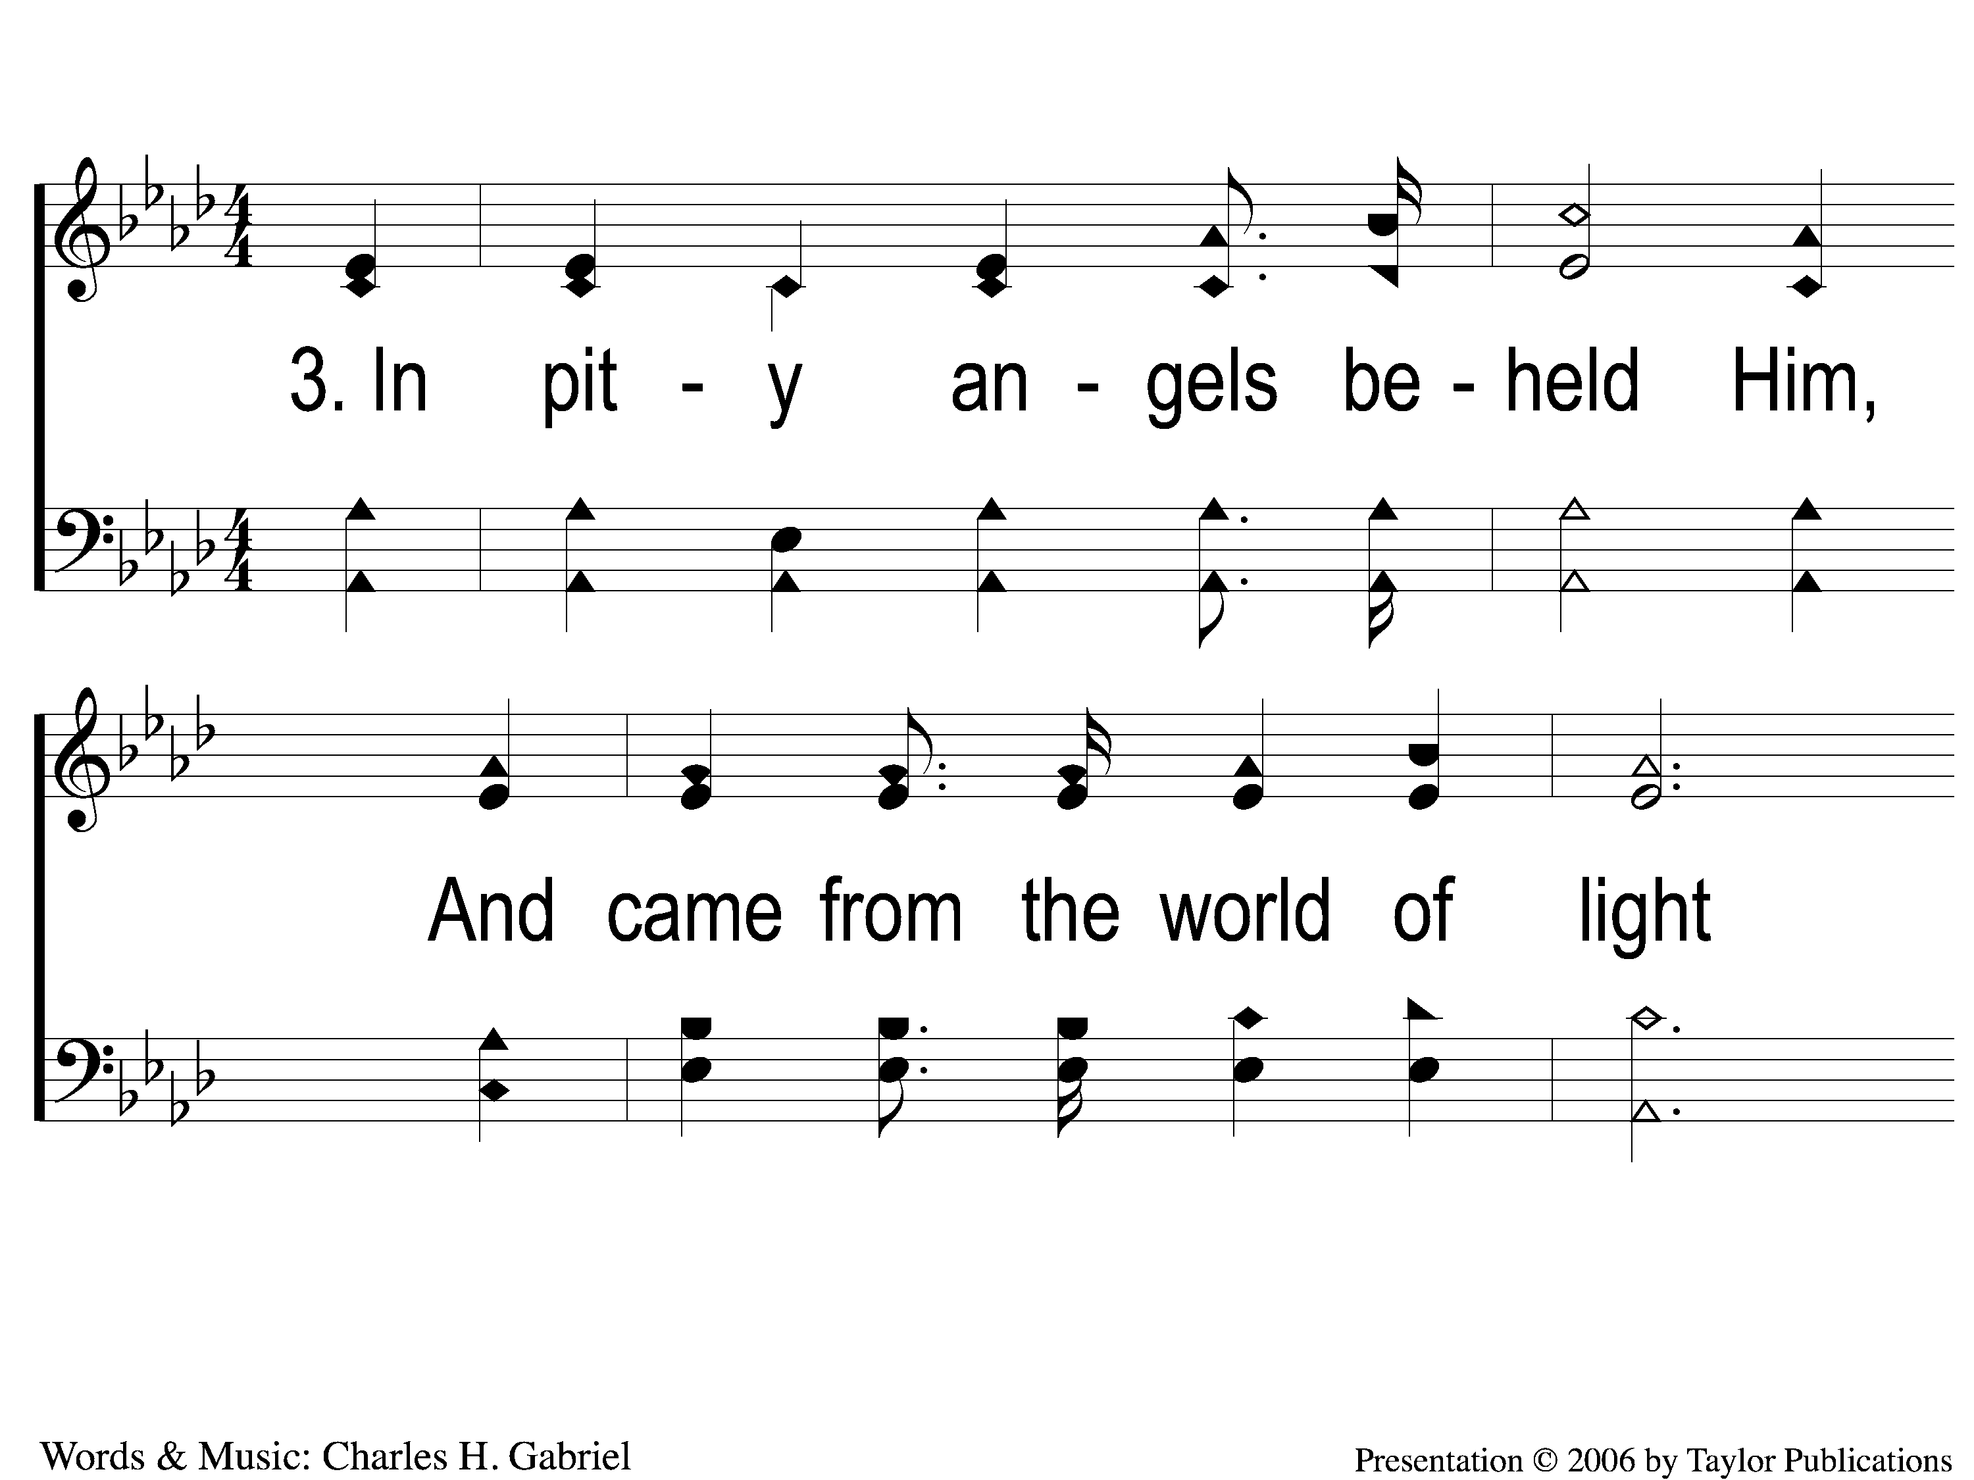
3-1 I Stand Amazed
I Stand Amazed
114

Slide 10
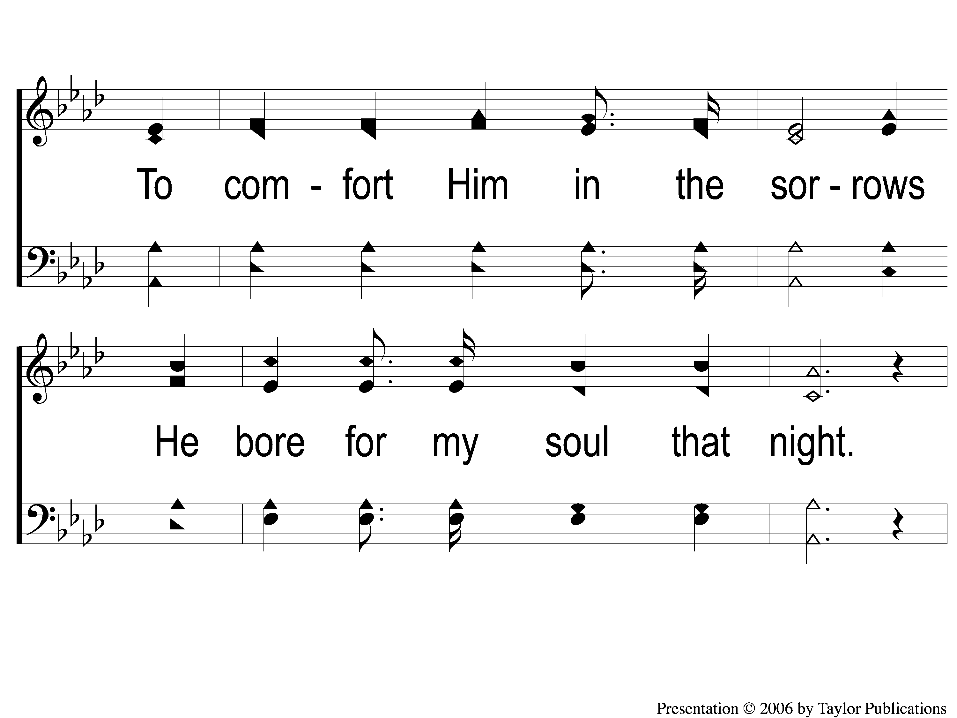
3-2 I Stand Amazed
I Stand Amazed
114

Slide 11
C-1 I Stand Amazed
I Stand Amazed
114

Slide 12
C-2 I Stand Amazed
I Stand Amazed
114

Slide 13
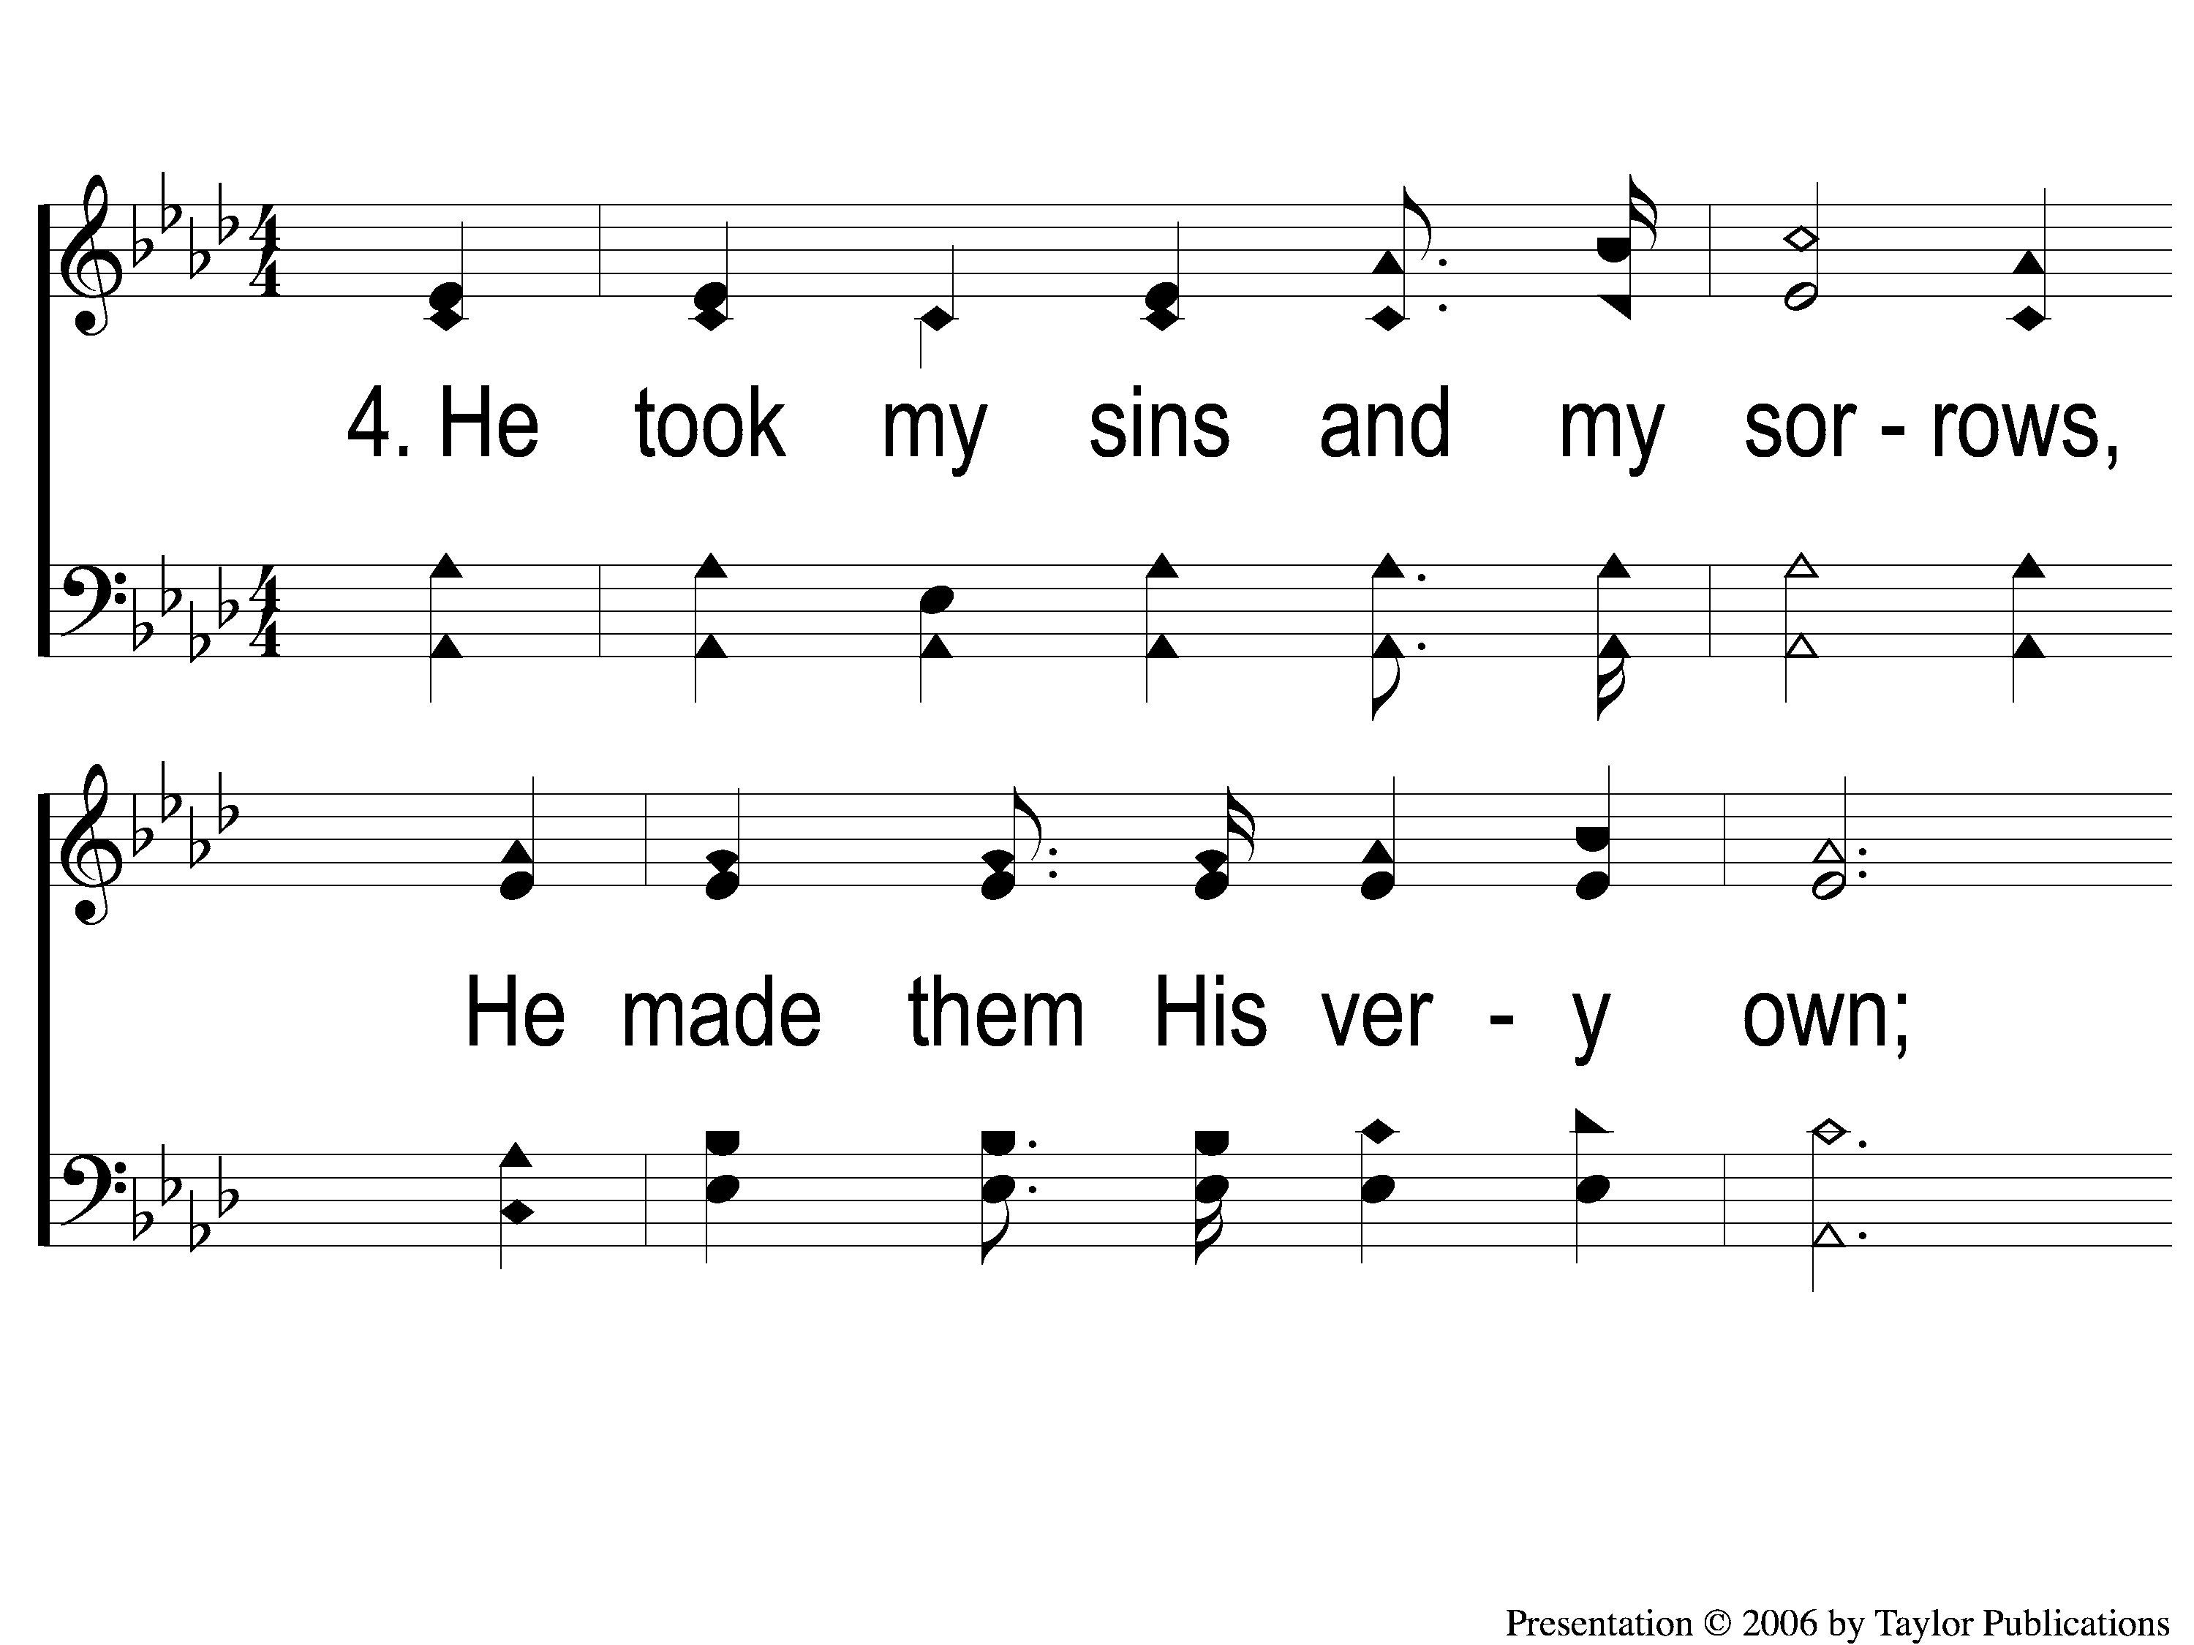
4-1 I Stand Amazed
I Stand Amazed
114

Slide 14
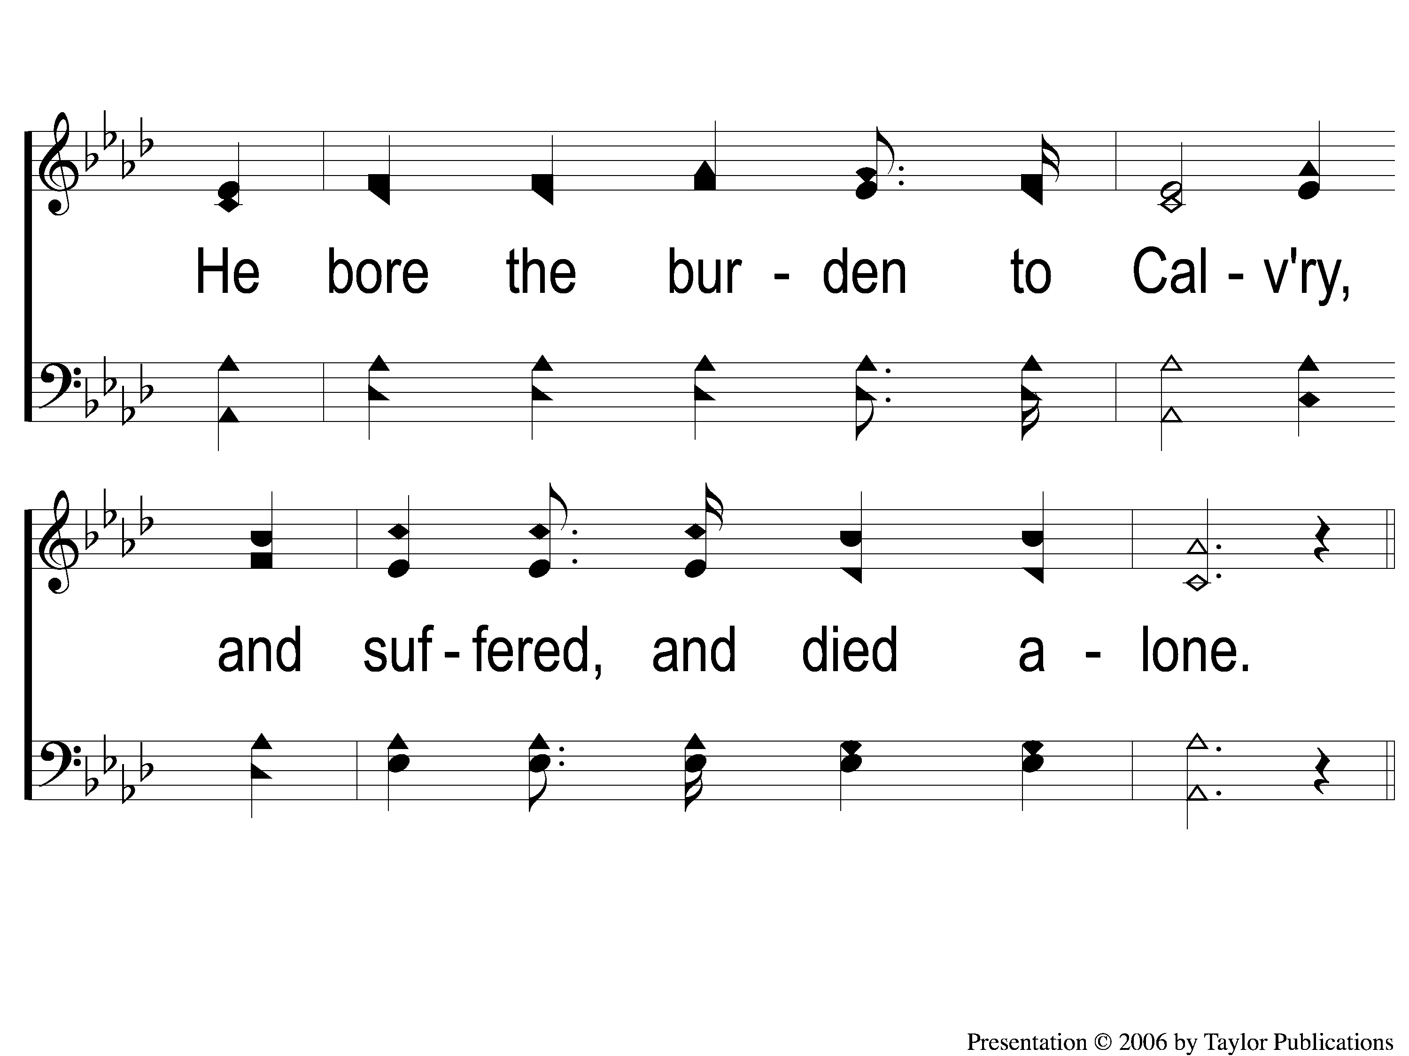
4-2 I Stand Amazed
I Stand Amazed
114

Slide 15
C-1 I Stand Amazed
I Stand Amazed
114

Slide 16
C-2 I Stand Amazed
I Stand Amazed
114

Slide 17
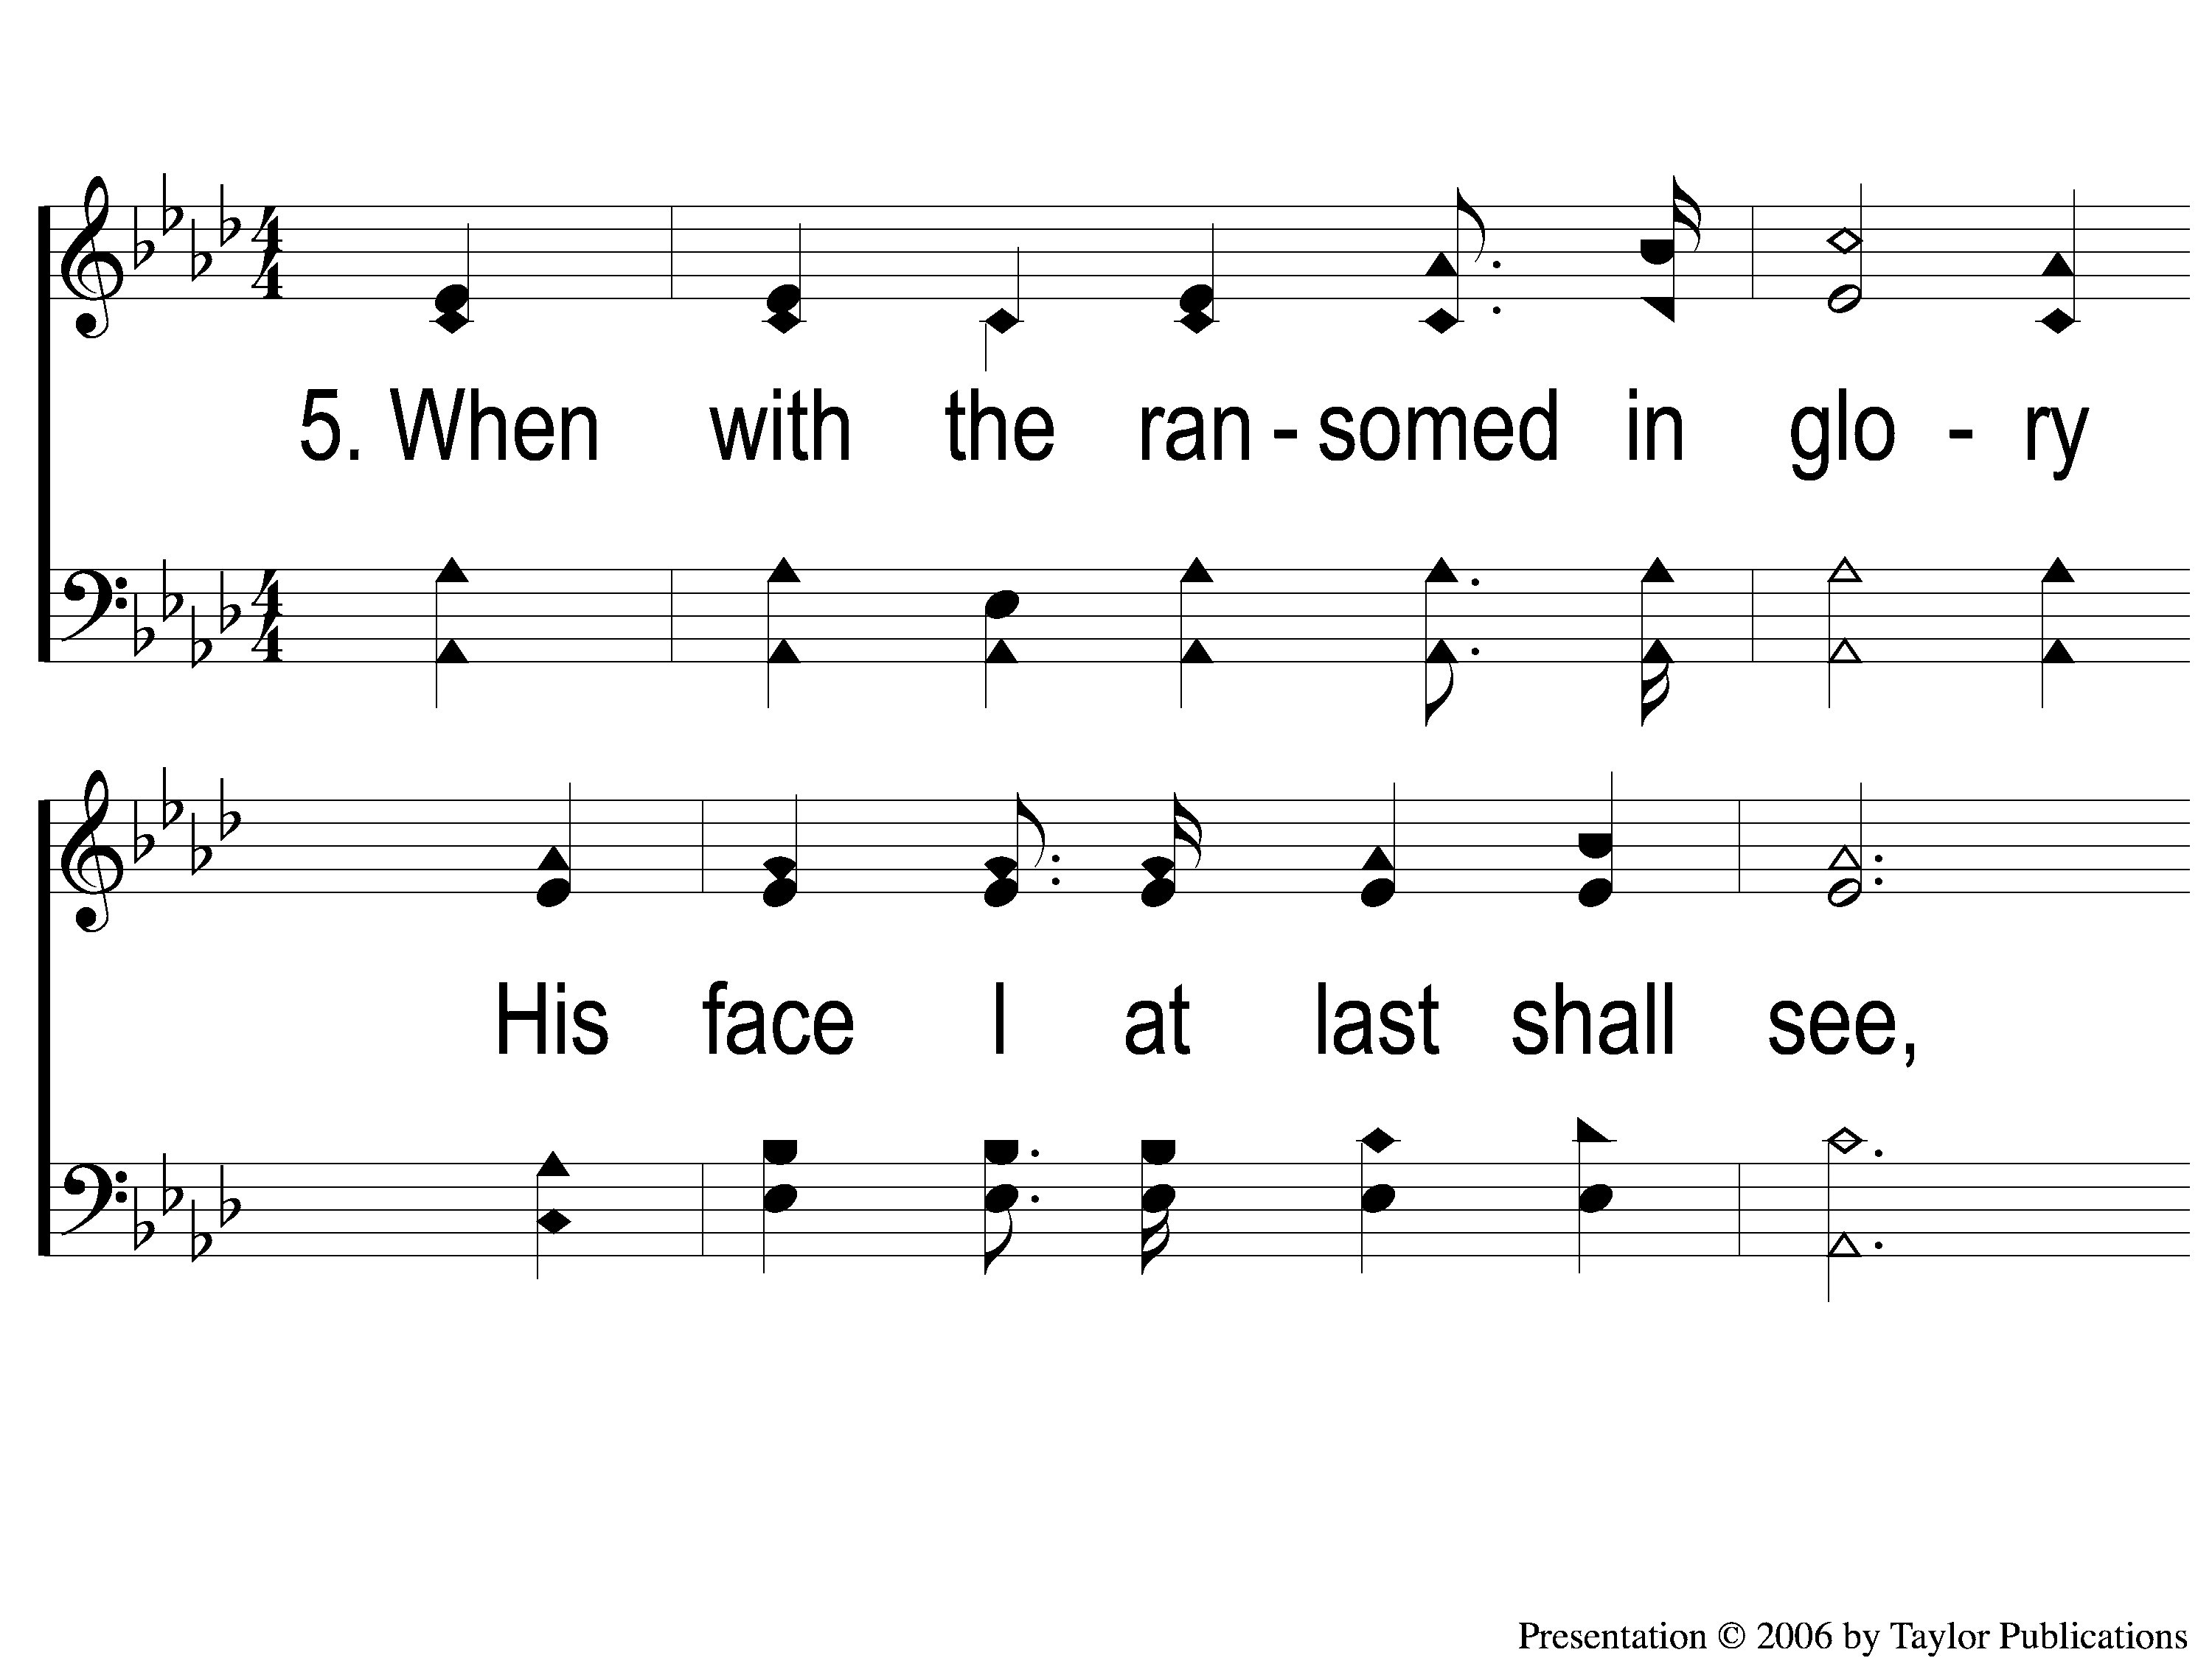
5-1 I Stand Amazed
I Stand Amazed
114

Slide 18
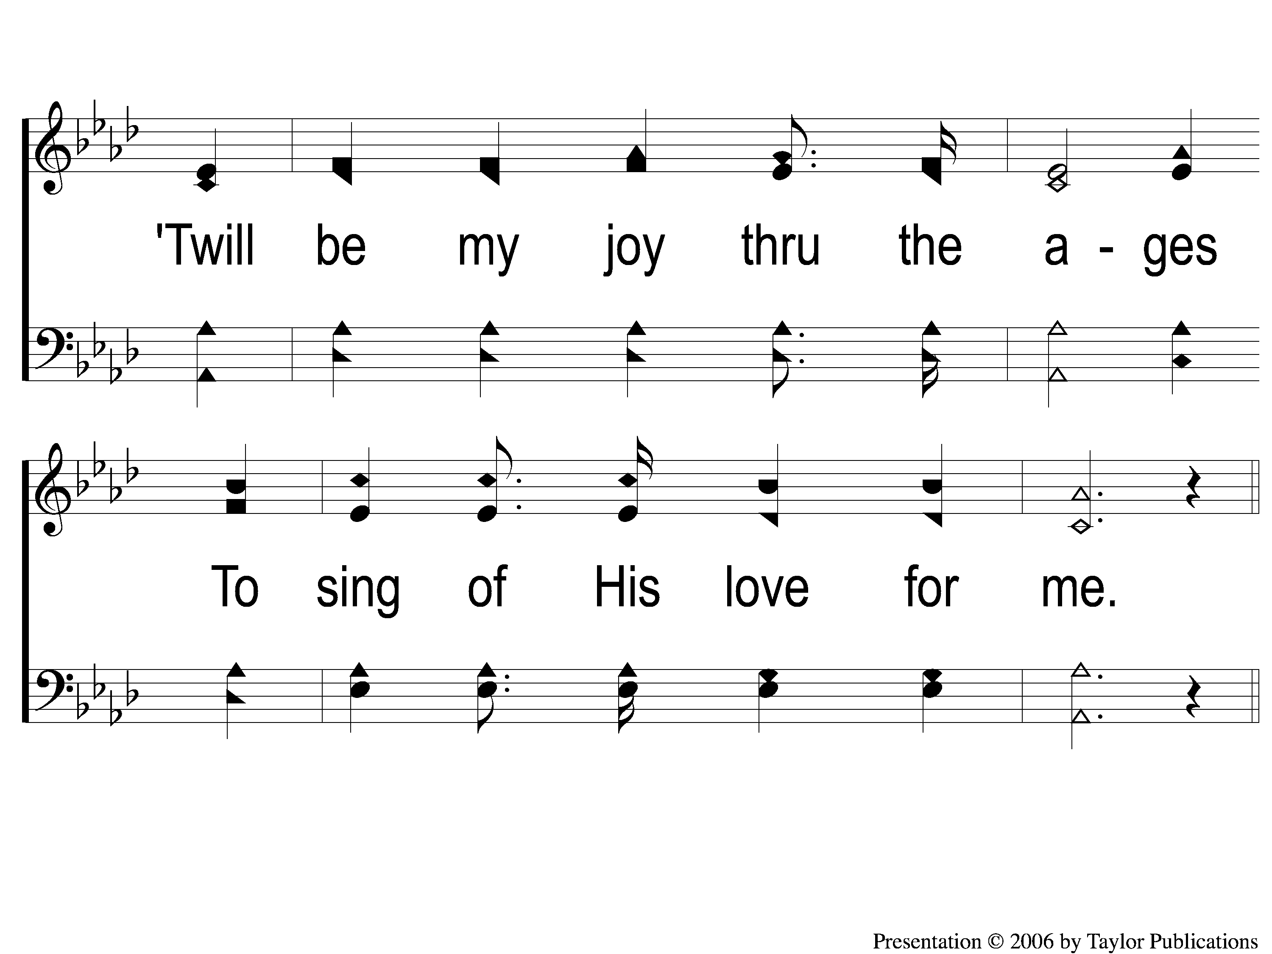
5-2 I Stand Amazed
I Stand Amazed
114

Slide 19
C-1 I Stand Amazed
I Stand Amazed
114

Slide 20
C-2 I Stand Amazed
I Stand Amazed
114

